Slide 1

MICROCONTROLLERS PROJECT THERMOSTAT CIRCUIT DESIGN

Slide 2
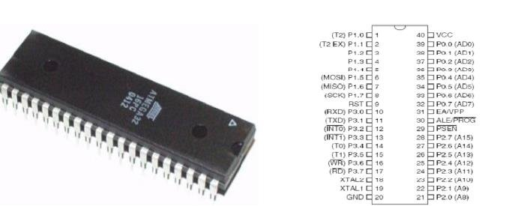
1. 8051 Family

Slide 3
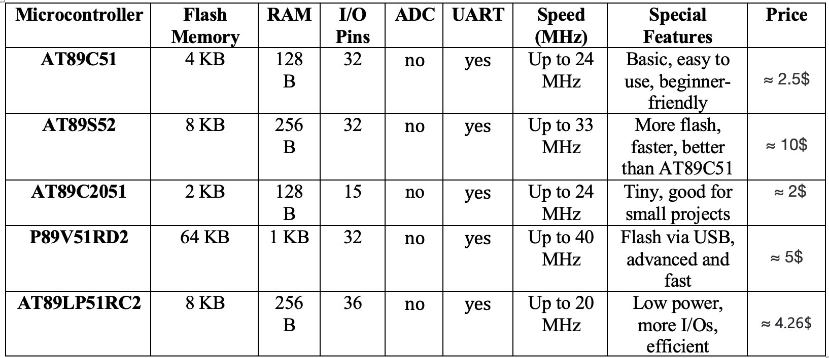
2. Microcontrollers comparision

Slide 4
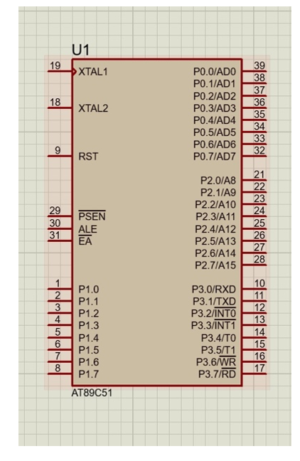
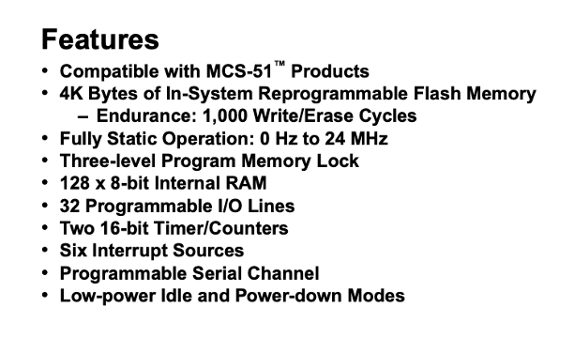
2.The Chosen Microcontroller

Slide 5
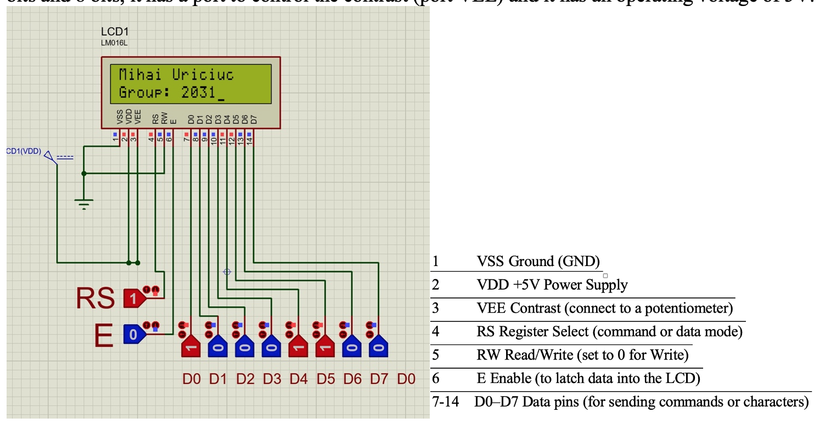
3.The LCD

Slide 6
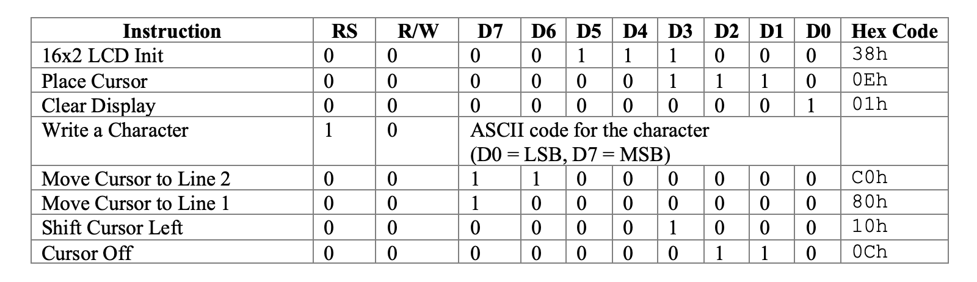
4. Instructions for the LCD

